Slide 1
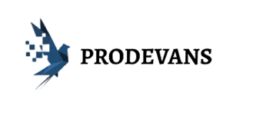

360 Degree MONITORING
TRIBE-O
Supervised by :- Dinesh Behera

Slide 2
TRIBE O
BACKEND TEAM | DOCUMENTATION TEAM
PRASAD MOHAN DHUPKAR (CO-LEADER) | ABHAY SINGH BAJETA (LEADER)
OMKAR SAMBHAJI DAMAME | SIDDIK JAHANGIR ATTAR
DEEPAK PANIGRAHI | SANTOSHINI NAIK
ABHIPSA SAMANTRA | SANTOSINI SATAPATHY
SUBHANGI SUBHADARSHINI NAYAK | SUNITA KUMARI NAYAK
 | BIDYUT NAYAK

Slide 3
OUTLINE AND CONTENT
Continuous monitoring and its need
Abstract
360 degree monitoring and why it need
Difference between Centralized monitoring and decentralized monitoring
What are tools and services we used
Nagios and its architecture
Zabbix and its architecture
What we offer
Flow of project
Outputs
Why not AWS Cloud Watch

Slide 4


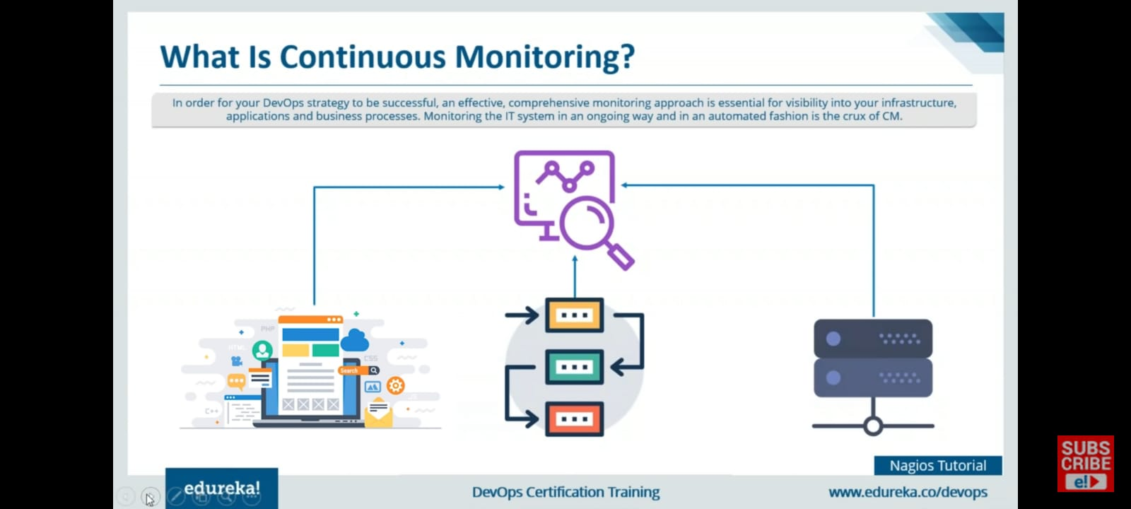
What Is Continuous Monitoring ?
In order to your Devops strategy to be successful , an effective comprehensive monitoring approach is essential for visibility into your infrastructure , applications and business processes . Monitoring the IT system in an ongoing way and in an automated fashion is the crux of CM.

Slide 5
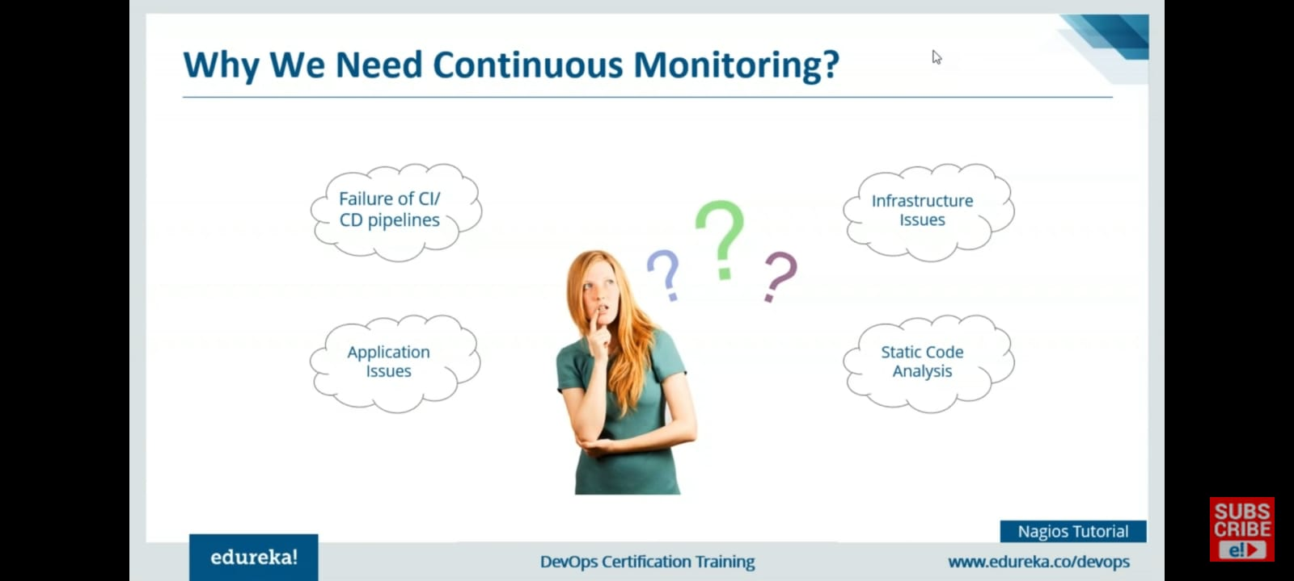

Slide 6
ABSTRACT
To selecting an infrastructure-monitoring suite, you need to take into account several factors to find the perfect match for your needs.
First, select a tool on the basis of the required functionalities and Business need
Next, evaluate the deployment and maintenance factors to match the tool with your IT team's resources and capabilities.
Finally, with a proper understanding of how the tool will affect your organization, calculate the total cost of ownership
we decide to develop a single solution which can do various kinds of monitoring's such as application/webserver monitoring, database monitoring, network monitoring, server monitoring, virtualization monitoring,

Slide 7
What Is 360⁰ Monitoring
360 degree monitoring is a full fledged monitoring provided to the customer server, application, database and network so as to make sure their business is not halted at any cost.
5

Slide 8
Why 360⁰ monitoring
Get complete visibility into your server health and performance
Frees up your IT resources
Improve end-user experience
Reduce downtime
Boost up Innovation

Slide 9
Difference between Centralized and Decentralized monitoring
Centralized Monitoring
Servers push to a centralized collection platform
High load of network traffic
Monitoring can become bottleneck
Decentralized Monitoring
Systems with units of computation that are physically or logically distributed.
Low load on network traffic .

Slide 10
Tools and services we used
NAGIOS – Monitoring Tool
POSTFIX – Push Notification Tool
ZABBIX – Monitoring Tool
AWS – Provides Infrastructure
8

Slide 11
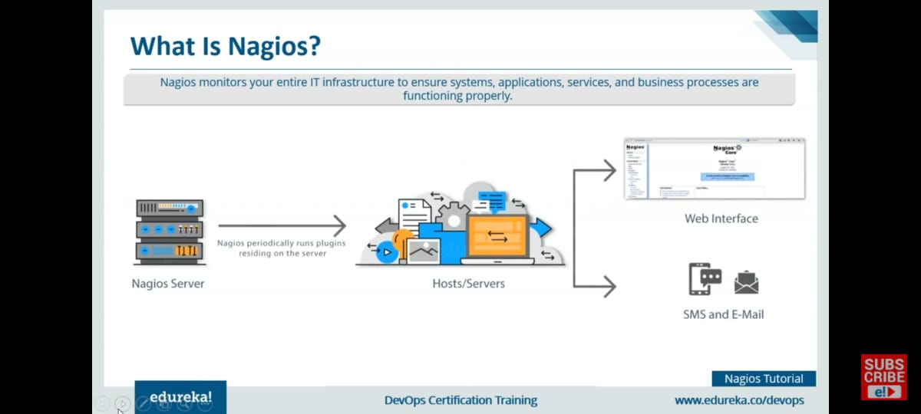
What is Nagios ?
Nagios monitors your entire IT infrastructure to ensure systems , applications , services and business process are functioning properly.

Slide 12
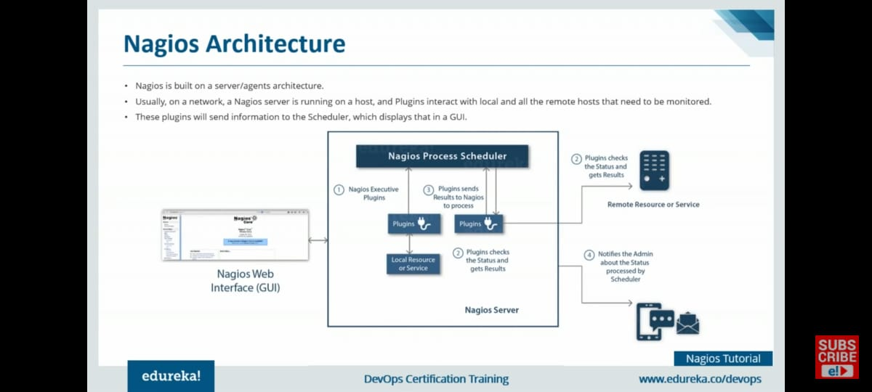
How Does Nagios Work - Architecture
Nagios is built on a server/agents architecture .
Usually , on a network , a Nagios server is running on a host, and Plugins interact with local and all the remote hosts that need to be monitored .
These plugins will send information to the Scheduler, which displays that in a GUI .

Slide 13
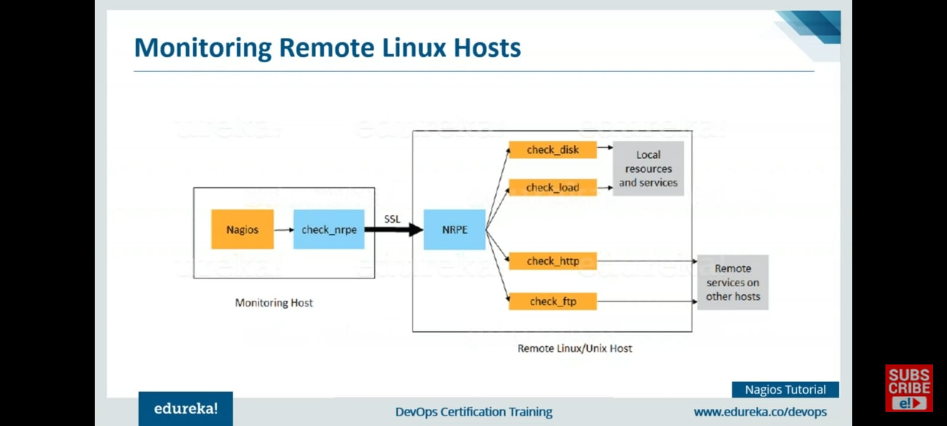

Slide 14
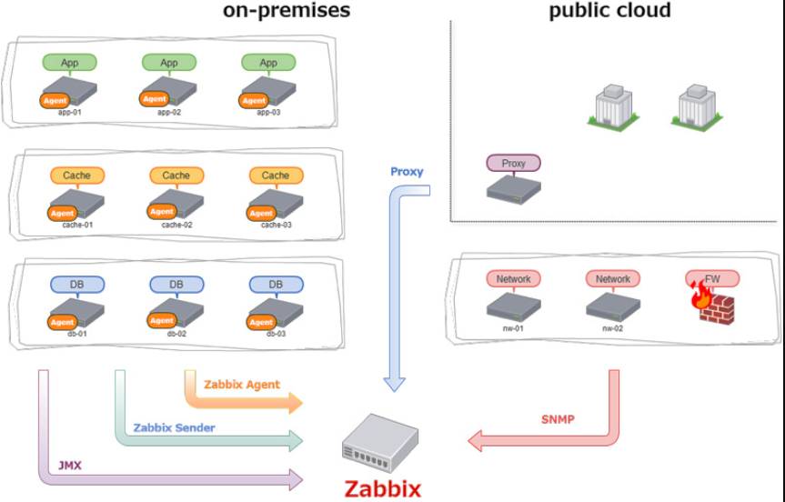
Zabbix
Zabbix is an open source monitoring software tool for diverse IT components , including networks , servers , virtual machine (VMs) and cloud services .

Slide 15
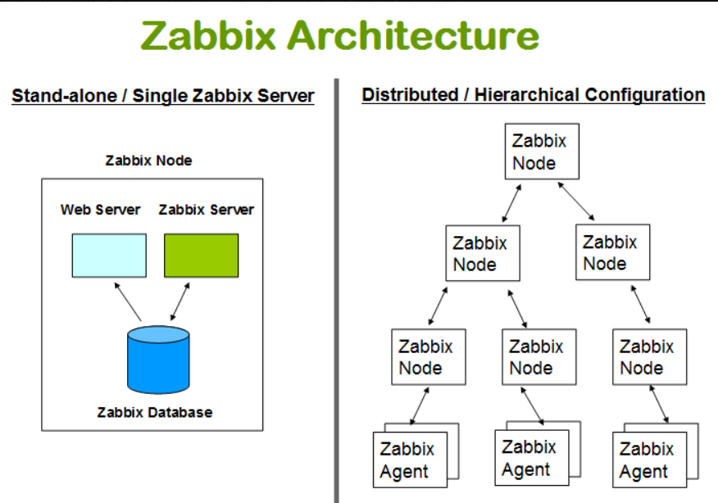
How Does Zabbix Work - Architecture
Zabbix uses client-server Architecture and uses an agent in the servers that should be monitored. This agent gathers all needed information and status from the system and sends to Zabbix server.
We are doing Stand-alone/Single Zabbix Server .

Slide 16
What do we offer
Server Monitoring
Webserver/Application Monitoring
Database Monitoring
14

Slide 17
Flow of project
Ubuntu 20.04 LTS CLI is required on EC2 instance.
Assigned IAM roles for collaborative work.
Assigned Elastic IP to all the instances.
Installed Nagios on host and remote.
Configured Plugins and NRPE on every instance.
Edited config file of Nagios and NRPE to add monitoring according to our need.
Deployed Webserver to monitor it.
Initiated MySQL database to monitor it.
Did Set up Postfix mailing service for Nagios; for alerting the Admin incase of any fault.
Installed another Open Source monitoring tool Zabbix to make it decentralized monitoring.
Configured Zabbix on remote and host.
Interlinked Zabbix and Nagios in order to if one goes down, others will inform the Admin.

Slide 18
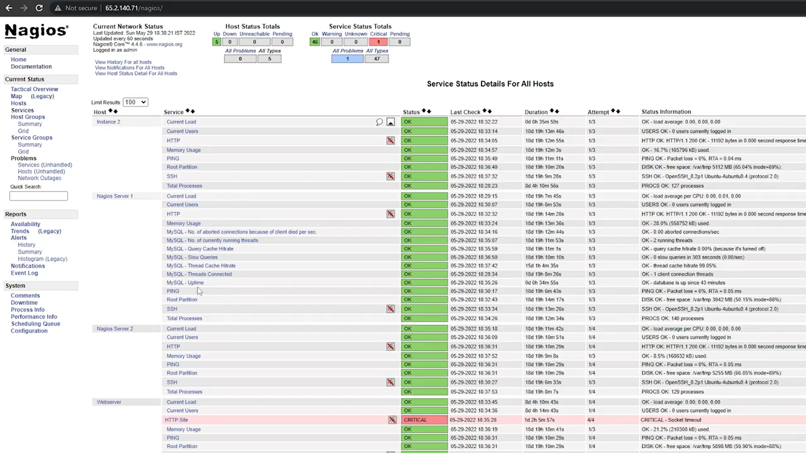
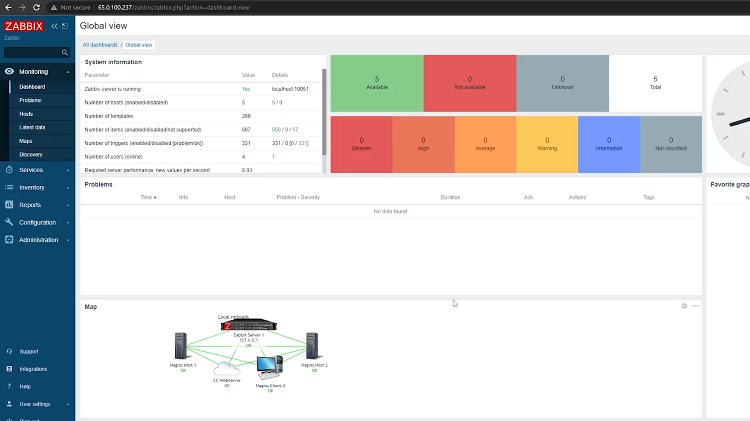
OUTPUTS
Nagios Dashboard
ZABBIX DASHBOARD

Slide 19
Why Not AWS Cloud Watch
Although using CloudWatch would been more easier as our project is totally hosted on AWS, but we choose not to use it because:
CloudWatch is centralized and could become slow when there are multiple push request from many services.
It is not an Open Source monitoring tool which affects privacy and security for companies.
CloudWatch is very expensive when compared to Open Source tools like Nagios and Zabbix which are 100 percent free to use.
17

Slide 20
THANK YOU

